Slide 1
Snake Game
Samuel Nadar 211132
2nd Year CSE

Slide 2
About the Game
It is the classical snake game where the snake has to collect as many fruits it can without hitting the obstacles
It is implemented using Object Oriented Programming Paradigms in C++
It runs on windows platform only
Motivation- recreating beautiful memories in the childhood

Slide 3
INITIAL PLAN
Basic Features
Additional Feature
Console
Snake
Fruit
Colourful
Obstacle
High Score

Slide 4
1. Console
It uses windows.h header file for graphics, hence it runs only on Window Platform
Console with colourful text and background
There are four screen-
i) Welcome Screen ii) Main Game ii) Game Over iv)Quit Game

Slide 5
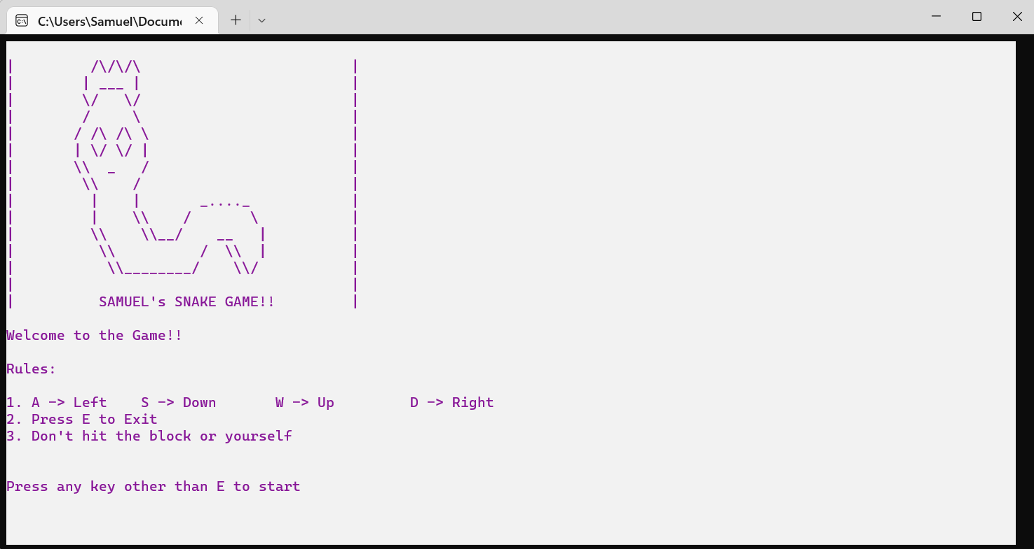
2. Welcome SCREEN
Contains the welcome message and rules
Once user hits any key other than E(which will cause to exit game) the screen is cleared and Game Screen is loaded

Slide 6
3. GAME SCREEN- Point
To create snake, fruit and obstacle user defined object Point is used
It can set the cursor to any given coordinates or set cursor to neighbouring points
It can draw and erase character in the given coordinates
It can also check whether two Points are colliding
If player press E, he will exit from game and quit game screen is loaded

Slide 7
4. snake
It is made of vector of points
Snake head will move in the direction stored in each step of loop
Other point will follow the previous coordinates of head
A, S, W, D keys are used to change the direction of snake (if possible)
Initially it consists of one point, when it eat fruit its size increase by one
The screen consist of boundary. If snake leaves the boundary it will come from opposite side. E.g. if it goes above the boundary it will come from below

Slide 8
5. fruit
The point is randomly put on screen where there is no snake and obstacle coordinates
When the fruit and snake head collides snake grow by one size
Any game is good when it has score
Each time snake consumes a fruit 1000 points are added
And with each movement 1 point is deducted from initial 1000 gift points
So if we consume many fruit in less time we will get high points

Slide 9
6. Obstacle
Here the top left and bottom right coordinates of various rectangular obstacle are only stored. (Inspired by CS101 CT-1 Turtle game Question)
If head of snake enters the obstacle zone, game is over
There are three collections of object which will come in random fashion in each game
If the snake collides with its own body, then also game is over
When a Game start obstacle is loaded, then as game goes on snake and fruit position changes using draw and erase function

Slide 10
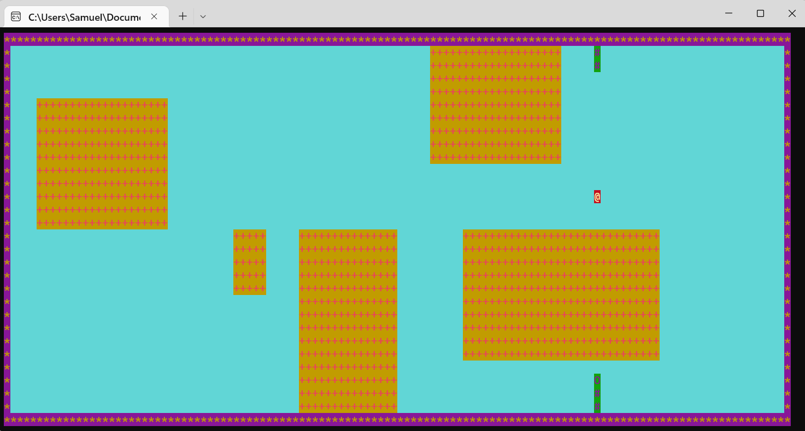
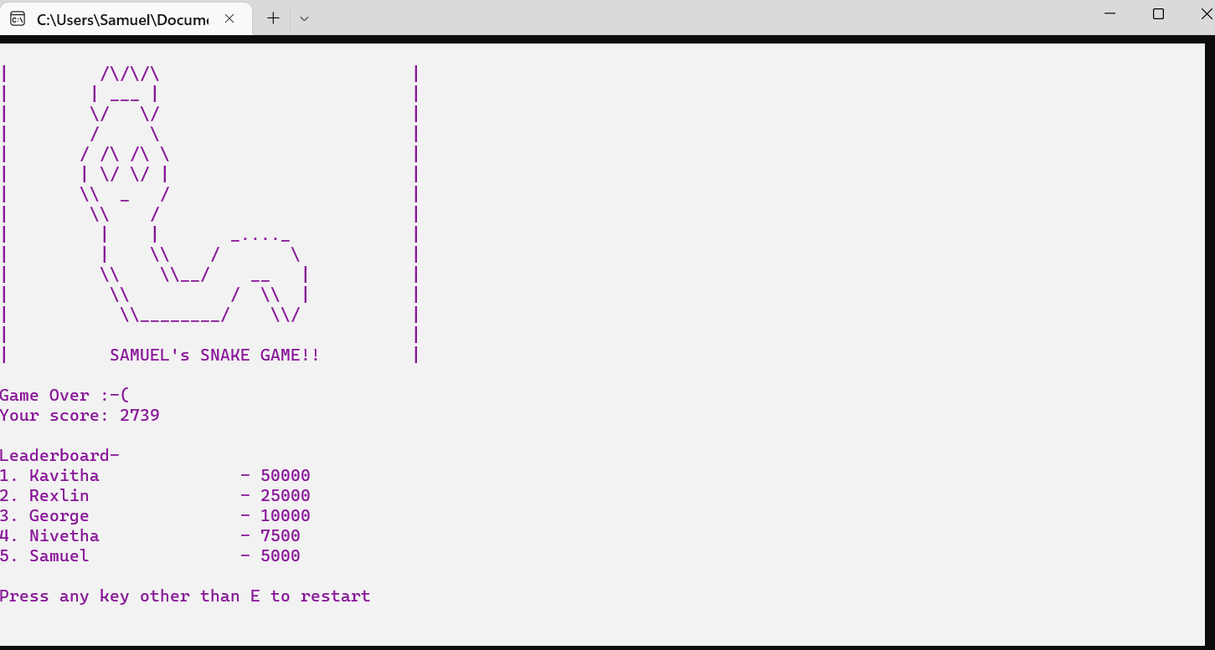
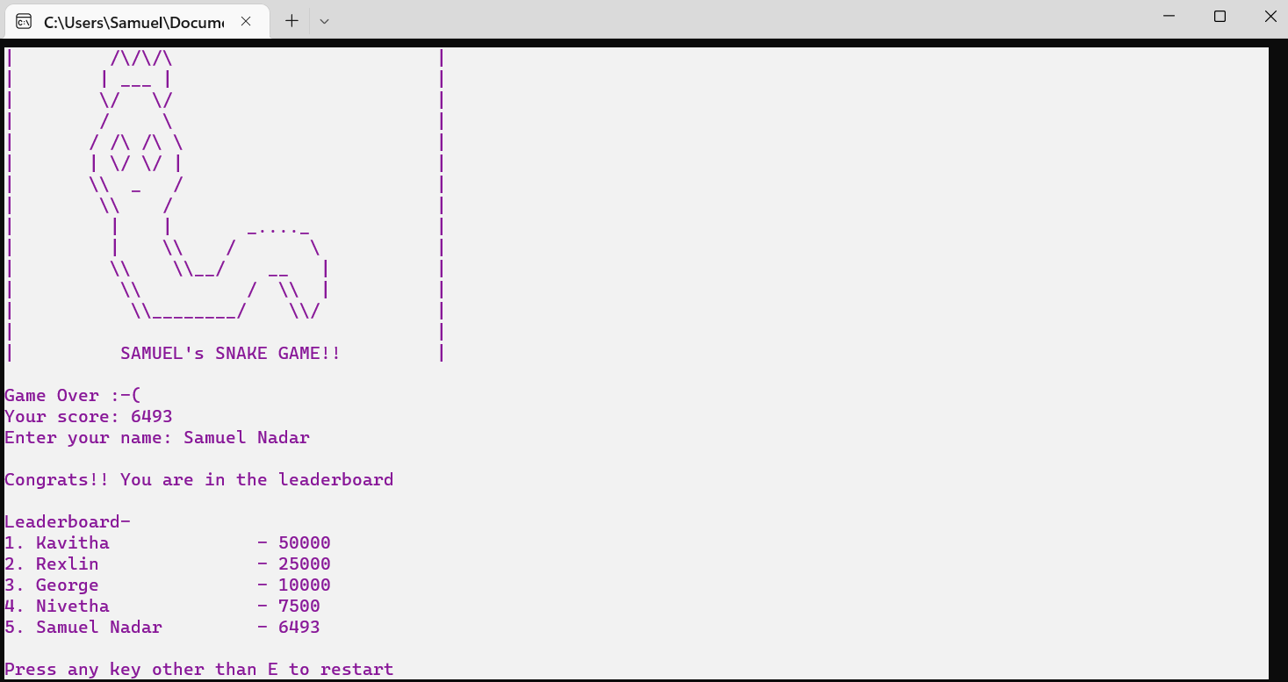
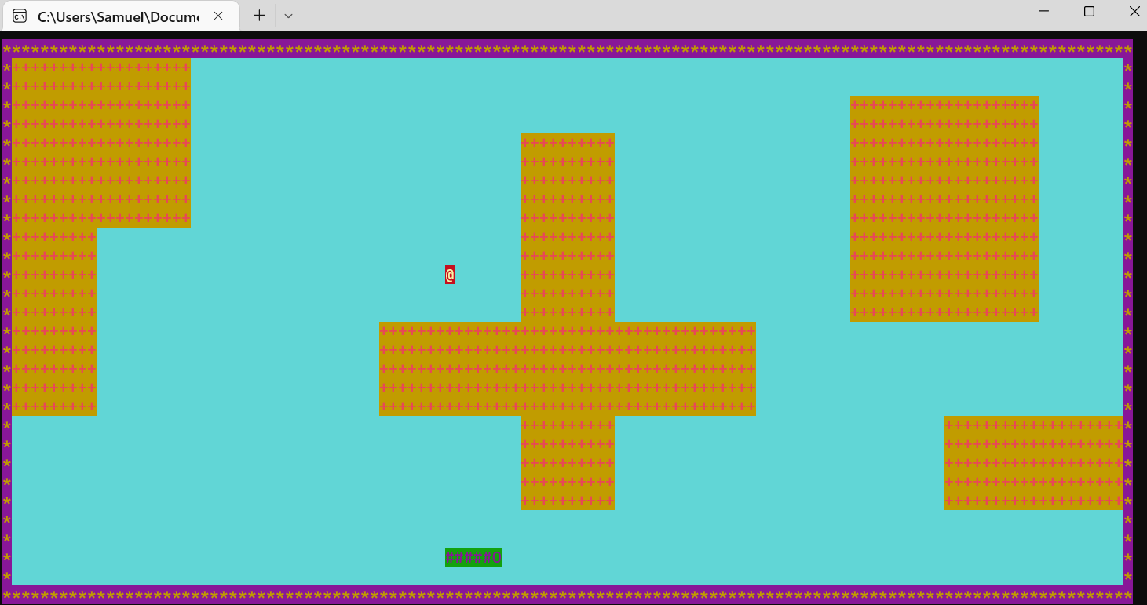

Slide 11
7. High scores
After game is over, top 5 scores along with their name is shown
This data is stored in a text file
If file does not exist then a default binary file with computer leader board is created
If the player has topped the leader board, his/her name will be asked and will be updated in file as well as printed
If the player press E, exit screen is loaded
If any other key is pressed, game will restart, game screen will be loaded

Slide 12
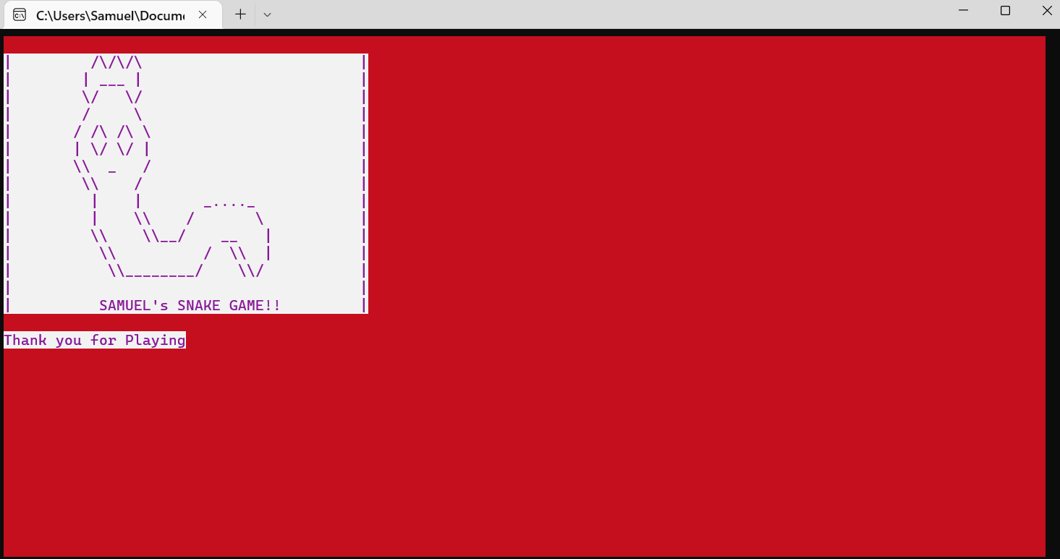
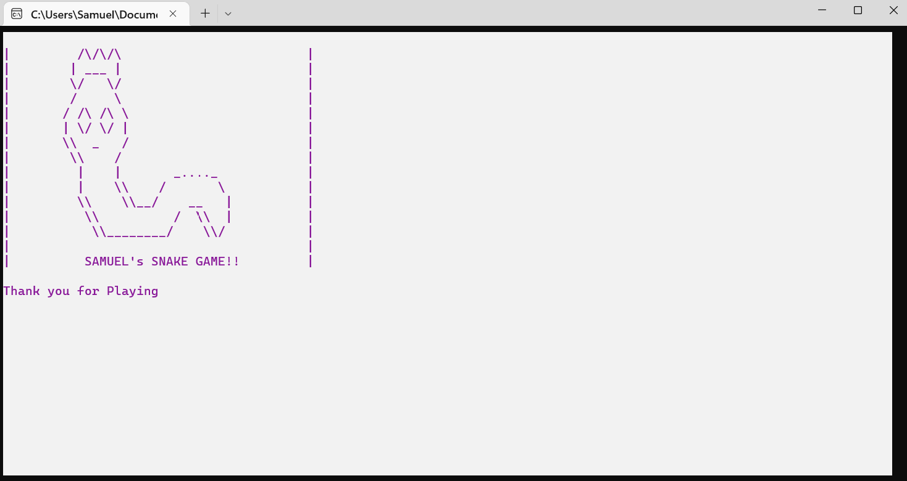
8. EXIT Screen
This screen is visible for 2 second and then the program terminates successfully
If the E is pressed in game screen, points are not stored, so red background
If it is printed in other screen, points are stored successful so there will be white background

Slide 13
Features in C++ USED
STL – Vectors, Pair, Algorithms
OOPs concept – Classes, Objects, Encapsulation, Data Abstraction
Inheritance
Polymorphism – Operator Overloading, Virtual Functions (Dynamic Binding)
Binary File Handling
I/0 Formatting

Slide 14
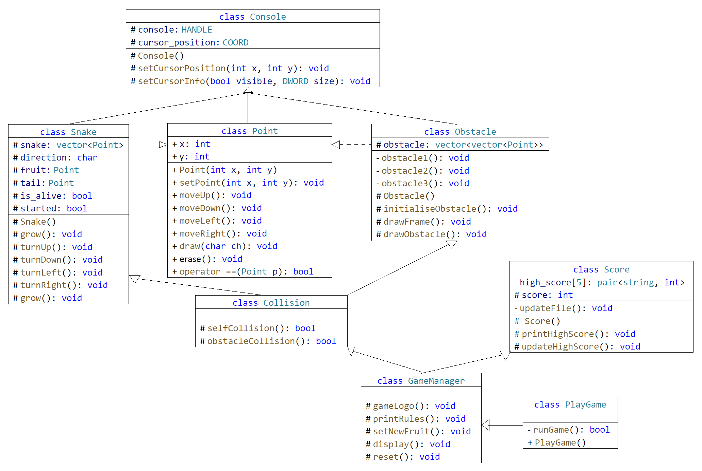
U
M
L

Slide 15
GITHUB PROJECT LINK
https://github.com/Samuel-Nadar1211/Snake-Game
I thank Dr. Anoop Jacob Thomas to give the opportunity to do this mini-project
I also thank all my peers who played this game and gave me their valuable feedback from which I could fix and improve my game code

Slide 16


